Slide 1

Account Page Design Studio
Login.gov
7/10

Slide 2
Design Studio
Official 18F description: “An illustration-based way to facilitate communication (and brainstorming) between a project team and stakeholders.”
Project phase | Discover
Notes:
Can be within a project team to gain shared understanding and make decisions on what to make.

Slide 3
What’s it good for?
To create a shared understanding and appreciation of design problems confronting the project team. To generate a range of possibilities for how to solve a design problem.
Project phase | Discover
Notes:
It’s a quick way to gut check quick solutioning and gather a range of possibilities to solve a problem

Slide 4
What isn’t it good for?
Not for - creating a highly detailed pixel perfect design.
Not for - final decision making on what to build
Not for - A detailed review of existing experiences provided either by direct competitors or by related agencies or services.
Project phase | Discover

Slide 5
Overview

Slide 6
⌚In the next hour...
Review research
Prioritization
Sketch
Discussion
Project phase | Discover

Slide 7
Effective design and implementation of authentication makes it easy to do the right thing, hard to do the wrong thing, and easy to recover when the wrong thing happens.
❤️
NIST - sp800-63b, section 10
Notes:
The goal of today is to come away with ideas for what needs to go into an account page and ideas for how it might be structured. From here I’ll refine these into digital wireframes and test them with the public to see if our design make it easy to do the right thing.

Slide 8
What you’ll need.
Paper
Dark colored sharpie or marker
For sharing, we’ll use the video chat, but also take pictures of your sketches (with your phone) and email them to [....]
Project phase | Discover

Slide 9
Ground rules
All ideas are welcome
“Yes and”
Everybody draws
Start with user needs
Project phase | Discover

Slide 10
How might we design an experience that makes it easy for someone to understand what the account page is and guide them to update their information?

Slide 11
1
Review research & hypotheses
What do we know about our users, their goals and pain points?
Project phase | Discover
Notes:
How might we help them reach those goals?
Have other sites solved similar problems?

Slide 12
How do other sites approach account management?
1 - Review research & hypotheses
Mental Models (how we perceive systems and interactions with them)
Find an app you haven’t used for over a month. One that required some personal information (Don’t open it yet)
Think about the steps you would take on that site to change your email address
Write or draw the steps you think you’d take to do so
Now open the app and compare the steps you expected to the way you had to navigate that experience.
Discuss quick impressions - what stood out?
Notes:
[5 minutes]

Slide 13
What we know about our users when they arrive at the account page?
1 - Review research & hypotheses
Thinking
This seems legit and secure, but I am not sure why I would need to access this.
I’m not sure why I would need to use login.gov, unless I couldn't make changes on USAJOBS.
I would assume I would log in to my one government account and see all my government benefits and services.
Doing (or might like to)
I need to change my address because I moved.
I need to access accounts I linked login.gov with.
I want to know what other services I can sign up for with login.gov

Slide 14
2
Prioritization
Review mural of research synthesis and add new ideas
Vote on top idea to focus on through sketching
Discuss the results
Project phase | Discover
Notes:
[10 minutes] Review previous sketches and ideas.
What do we like about them?
What doesn’t work?
Are there other things we should consider?
Everyone gets three votes - can vote on anything in the synthesis
All of this is important to keep in mind while sketching but to make sure our sketches are clear we need to have ONE thing be the top focus.

Slide 15
3
Sketch!
Warm up!
Sketch!
Share sketch
Either take a photo and DM @Nick
Or hold up sketch for Nick to screengrab
Project phase | Discover
Notes:
Review mural sketches
Round 1
Sketch - Divide page in 4
Think about features that would help a user
Quick show and tell
Round 2 - create one layout with the best of the ideas you
Sketch
Discussion

Slide 16
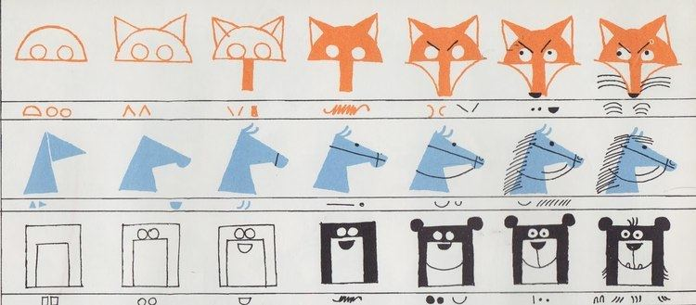
✍ Simple shapes = 🖼 Art!
© Ed Emberley
Notes:
[30 seconds] Anyone that can draw a line can draw a fox

Slide 17
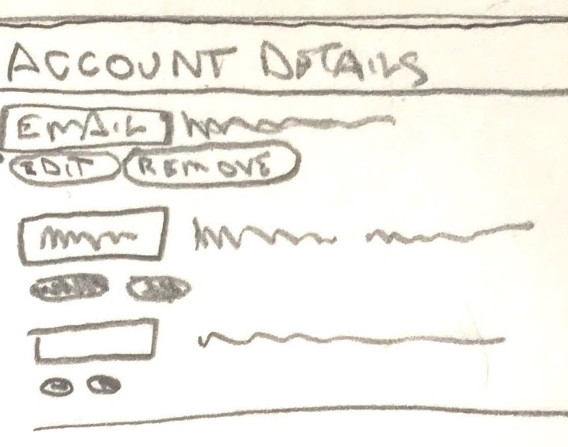
🎨 ⏲ Drawing for speed/clarity
Keep it simple! Draw only as much detail needed to get and ideas across
Label section titles clearly
Simplify repeated words and shapes
You can shorthand text with scribbles or lines
Notes:
Quick line drawings are as detailed as we’re looking for.

Slide 18
3
Sketch!
Warm up!
Sketch!
Share sketch
Either take a photo and DM @Nick
Or hold up sketch for Nick to screengrab
Project phase | Discover
Notes:
Review mural sketches
Round 1
Sketch - Divide page in 4
Think about features that would help a user
Quick show and tell
Round 2 - create one layout with the best of the ideas you
Sketch
Discussion

Slide 19
4
Discussion & wrap up
Present [<1 min per person]
Discuss
Project phase | Discover
Notes:
Where do we go from here?
Everyone briefly talks about their designs - what they drew, how they think it addresses the problem.
Next Steps
Pick one design to wireframe or pull from best idea from ALL the designs.

Slide 20
Thank you!

Slide 21
More on
methods
https://methods.18f.gov/
https://github.com/18F/methods
TTS slack: #18F-methods

